Slide 1

MAKING INFORMATION FINDABLE FOR NYC.GOV
Guided By
Prof. Stacey Sarris

Slide 2


Aanshi Shah
Aanshi.Shah@pace.edu
Kajal Purwar
Kajal.Purwar@pace.edu
Nishant Kadu
Nishant.R.Kadu@pace.edu

Slide 3
Problem Statement
While achieving the goal of fitting enormous amount of information, NYC.Gov faces issues of
Information Redundancy Tedious Scrolling and Browsing
Information Prioritization
Confusing Labels
to reach the target information

Slide 4
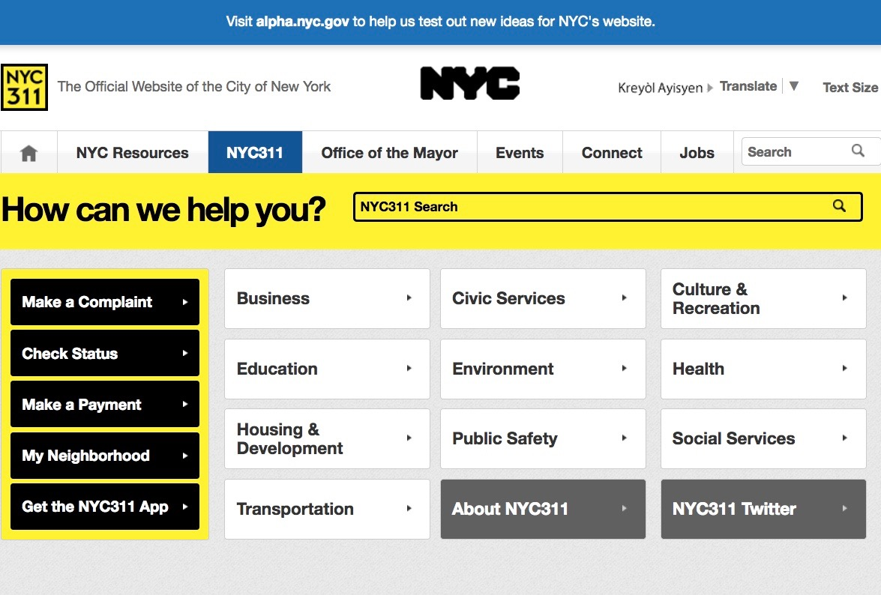
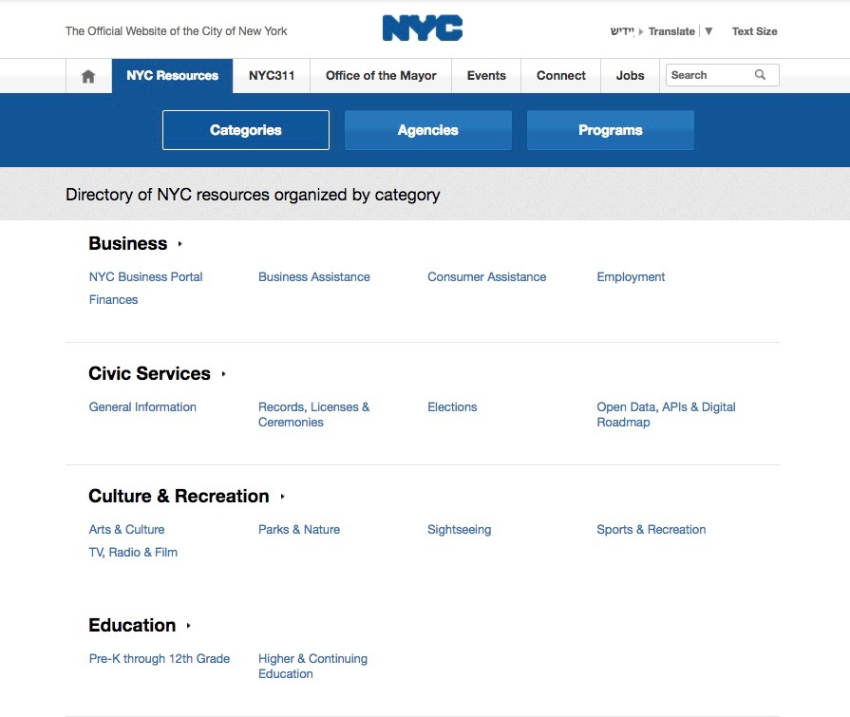
Problem 1: Users observed information redundancy across global navigation
Redundancy NYC resources and NYC 311 both are having same name on menus also when we clicked on it, get a same page and replicate information on it

Slide 5
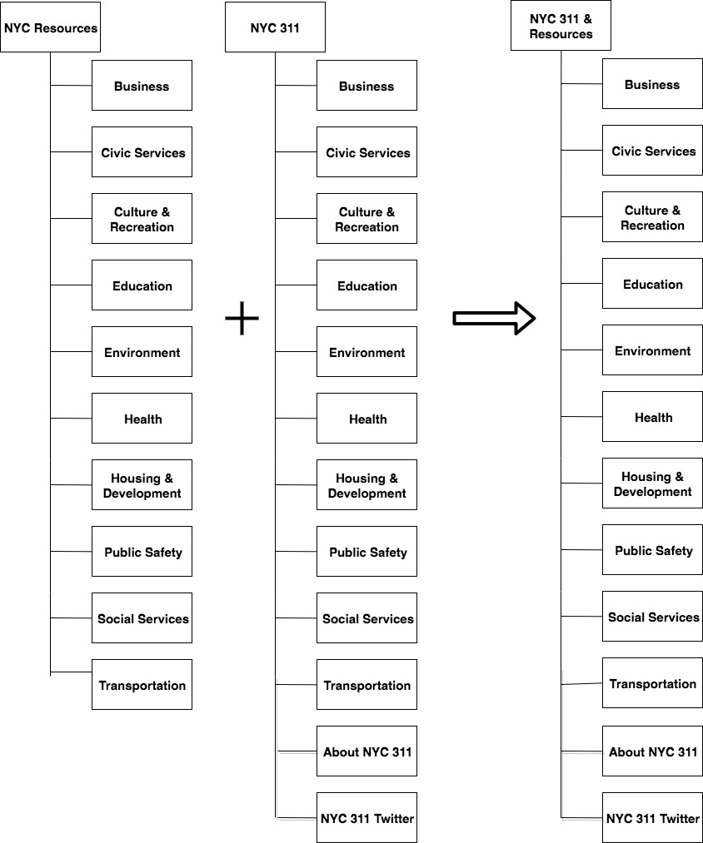
Solution1: Combined menus without information loss

Slide 6
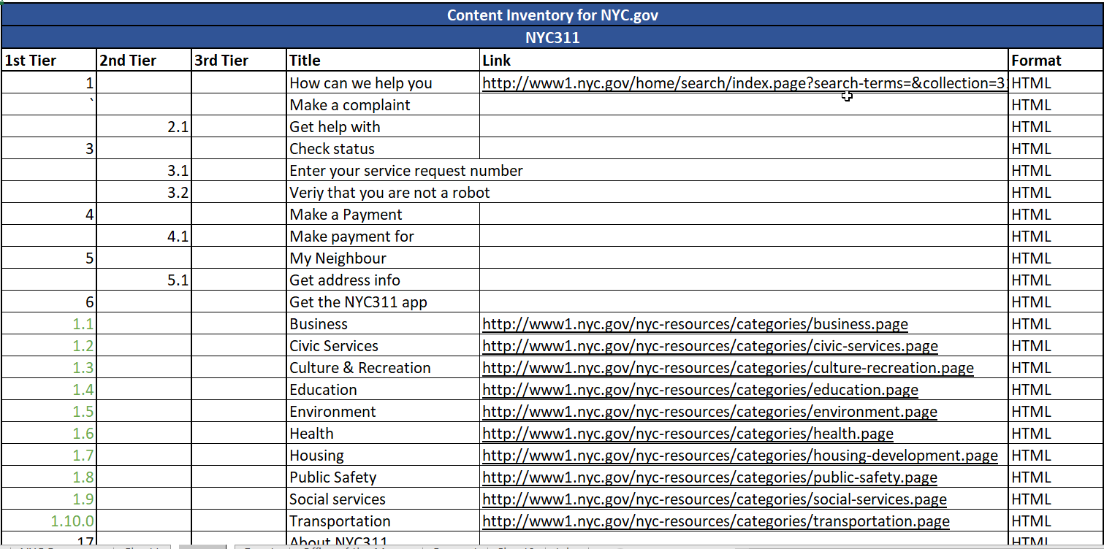
Approach: Content Inventory

Slide 7
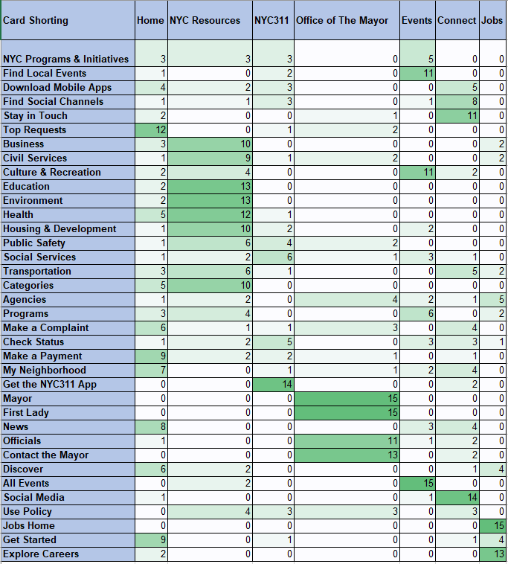
Approach: Card Sorting iteration 1
Number of Users:
15
Users Location:
NYC
User Type:
Citizen/ Students/ Teachers and immigrants

Slide 8
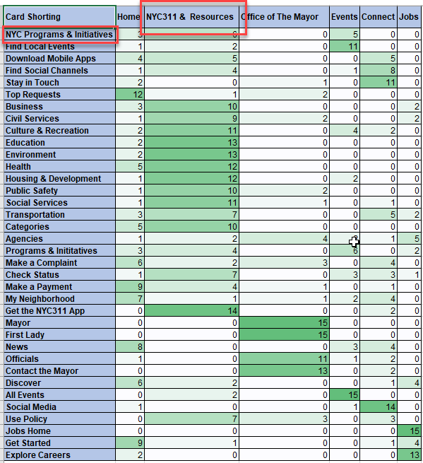
User Research: Card Sorting on Solution(Iteration 2)
Number of Users:
15
Users Location:
NYC
User Type:
Citizen/ Students/ Teachers and immigrants

Slide 9
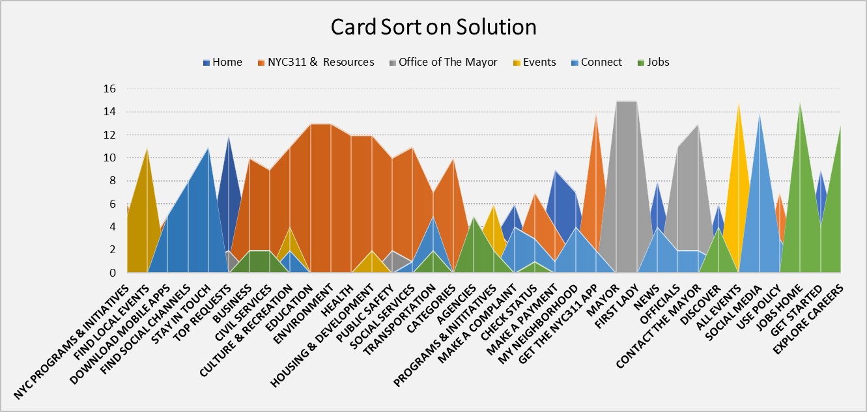
User Research: Card Sorting on Solution(Iteration 2)

Slide 10

Personas for Solution 1
Name:
Melody Farazmand
Demographics:
Age: 26 yrs
Lives in: Brooklyn, NY
Works in: Manhattan
Occupation: Data Scientist
Objectives for NYC.Gov website:
Easy Navigation
Scenario:
Register credit card fraud at NYPD
Quote for insight:
“I inputted my query in search results but only outdated information showed up. I couldn’t look for what I wanted and therefore I had to call NYC311”

Slide 11
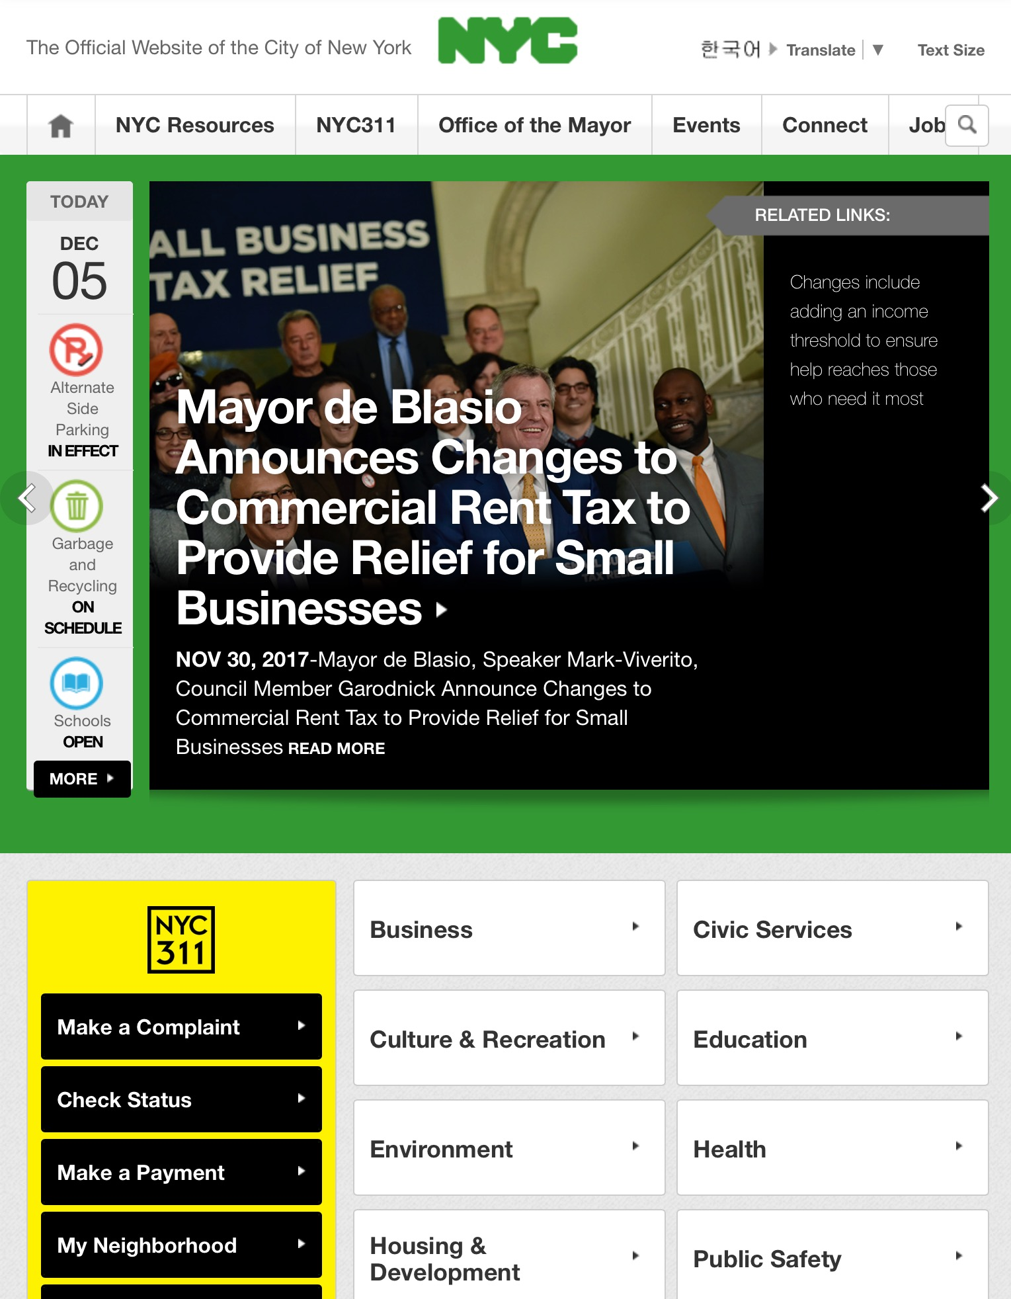
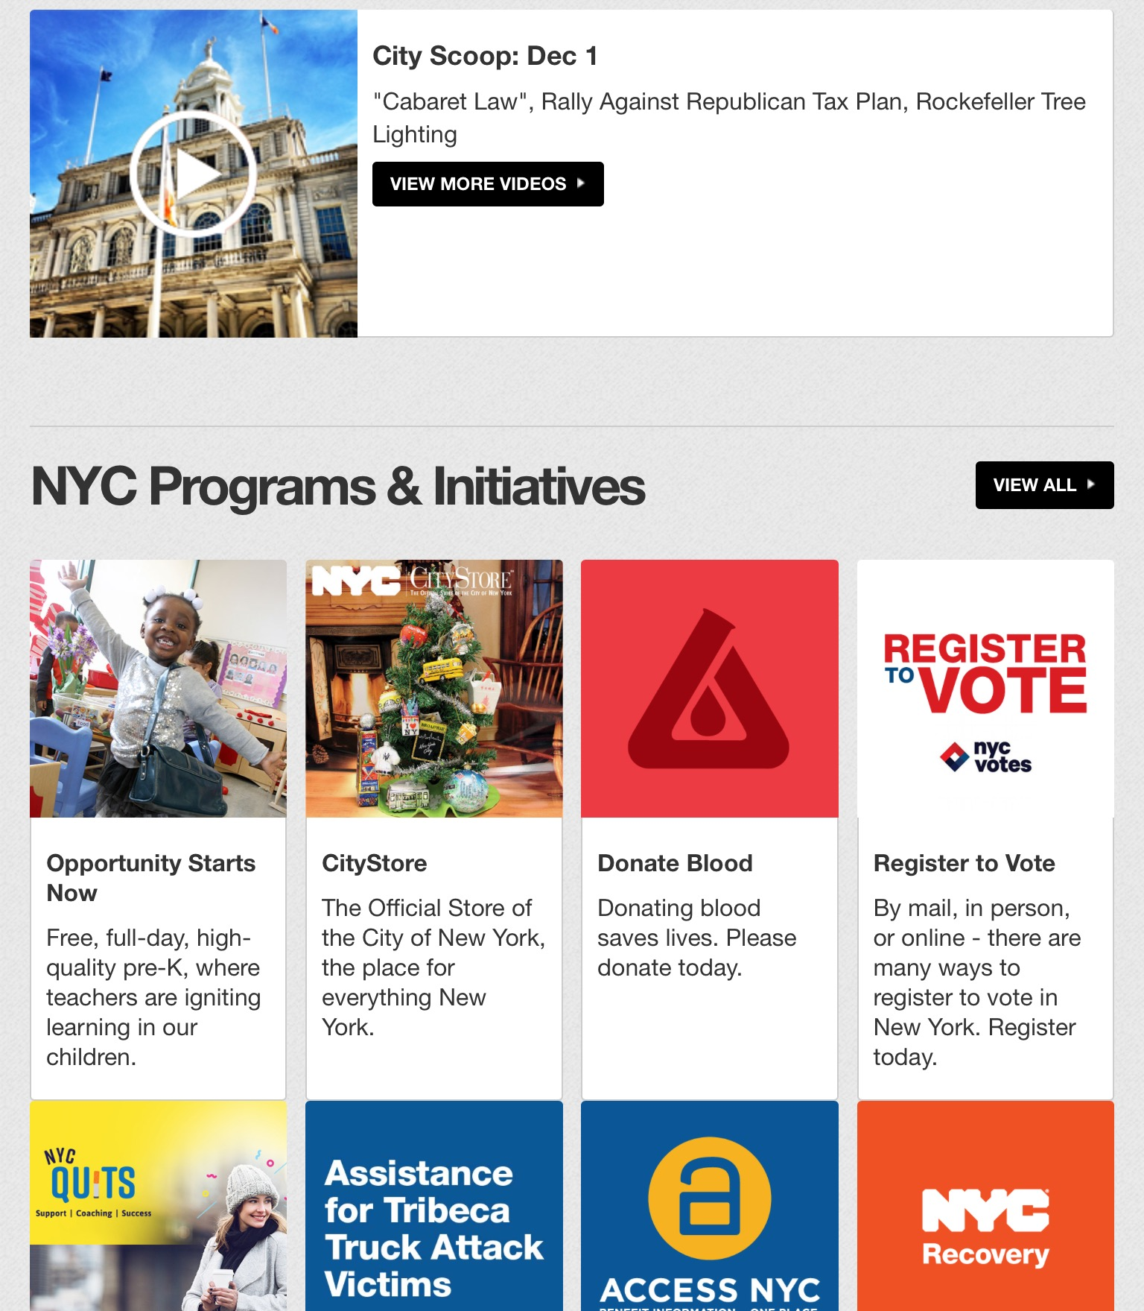

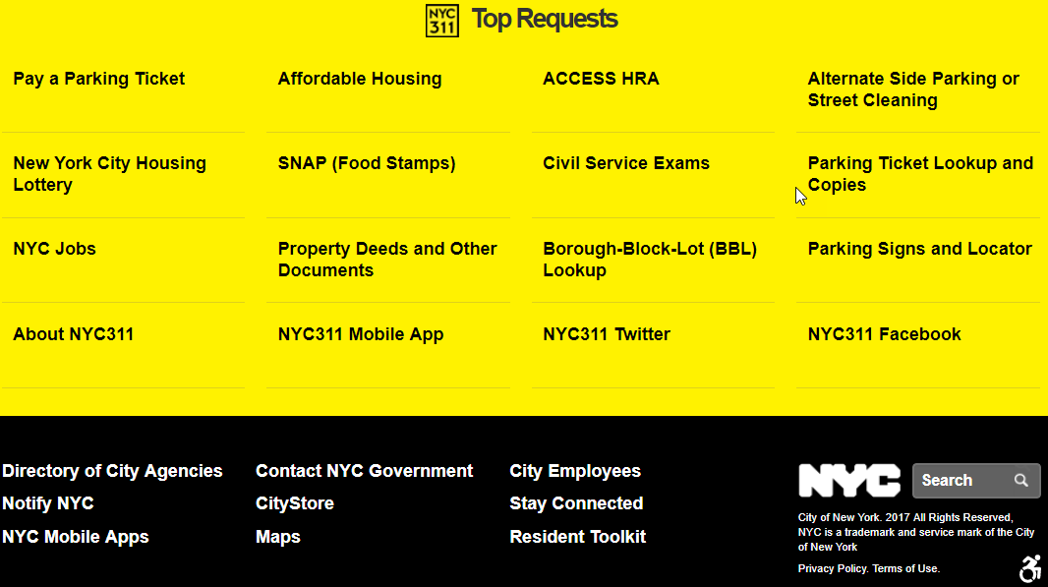

Problem 2: ‘Top Request section is at the bottom of the page’
1
2
3
4

Slide 12

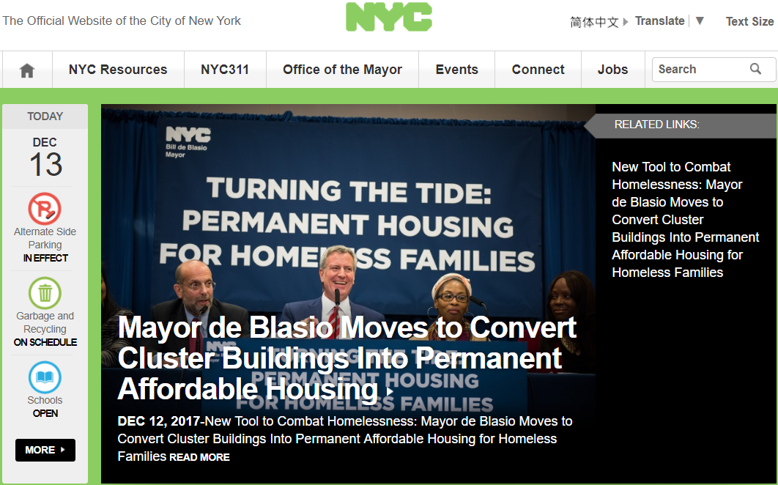

Solution2: ‘Top Request section should be towards the top of the page’
Top Requests
Option1
Option3
Pay A Parking Ticket
Housing
Access HRA
Parking Ticket
NYC Jobs
Option2

Slide 13
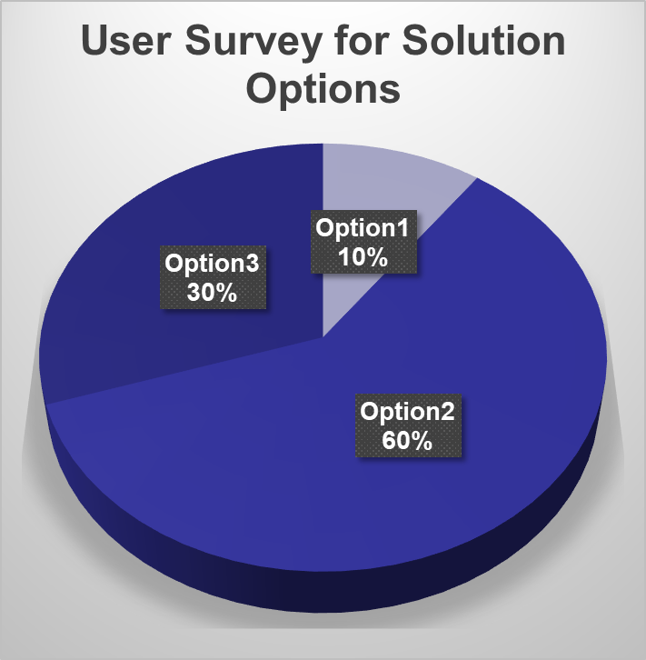
Solution2: ‘Top Request section should be towards the top of the page’

Slide 14
Solution2: ‘Top Request section should be towards the top of the page’
Top Requests
Option2

Slide 15
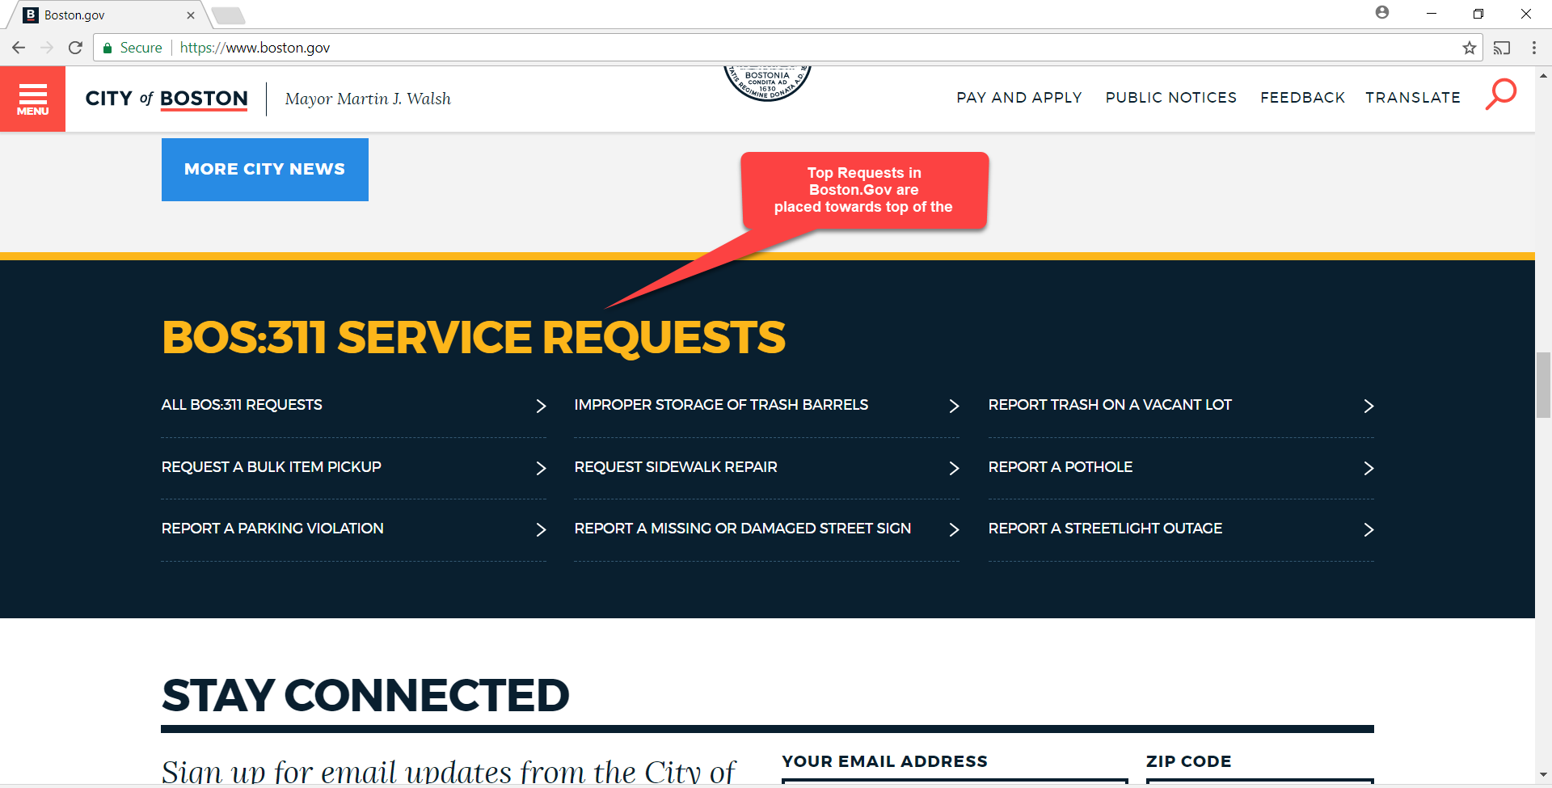
Approach: Competitive Analysis- Benchmarking

Slide 16

Personas for Solution 2
Name
Lu Si Bo
Demographics:
Age: 32 yrs
Lives in: Bronx, NY
Works in: Manhattan
Occupation: Teacher
Objectives for NYC.Gov website:
Quick and accurate search results
Scenario:
Parking information for Uhaul
Group passes information for school picnic
Quote for insight:
“Requests like Parking and Train passes are so common. I am not sure why I can’t find it easily. Am I doing something wrong?”

Slide 17
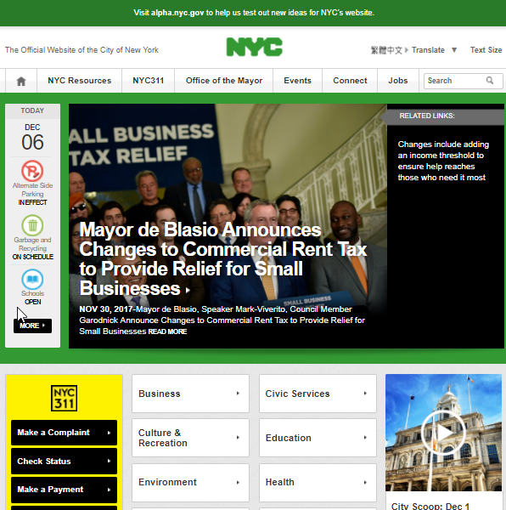
Problem 3: Users wanted alerts to be highlighted but Alerts were entirely missing on home page

Slide 18
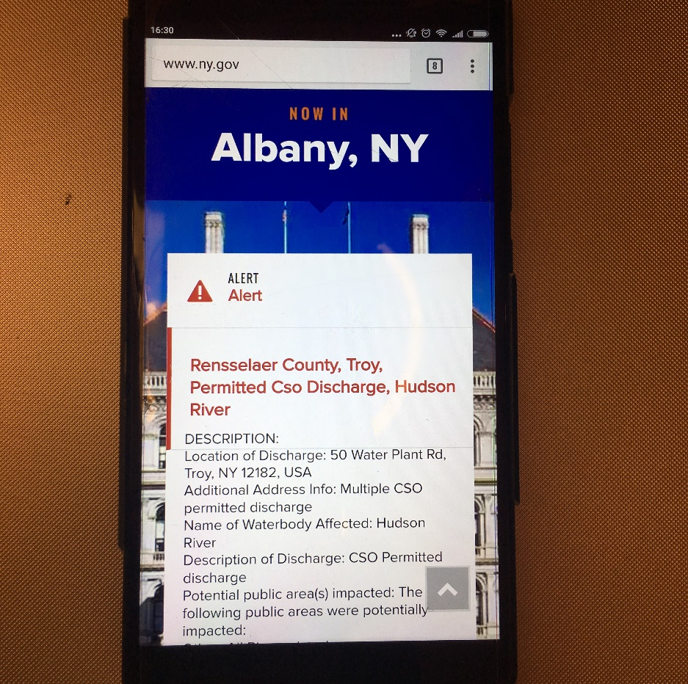
Self Benchmarking: Mobile Version of website contained alerts

Slide 19
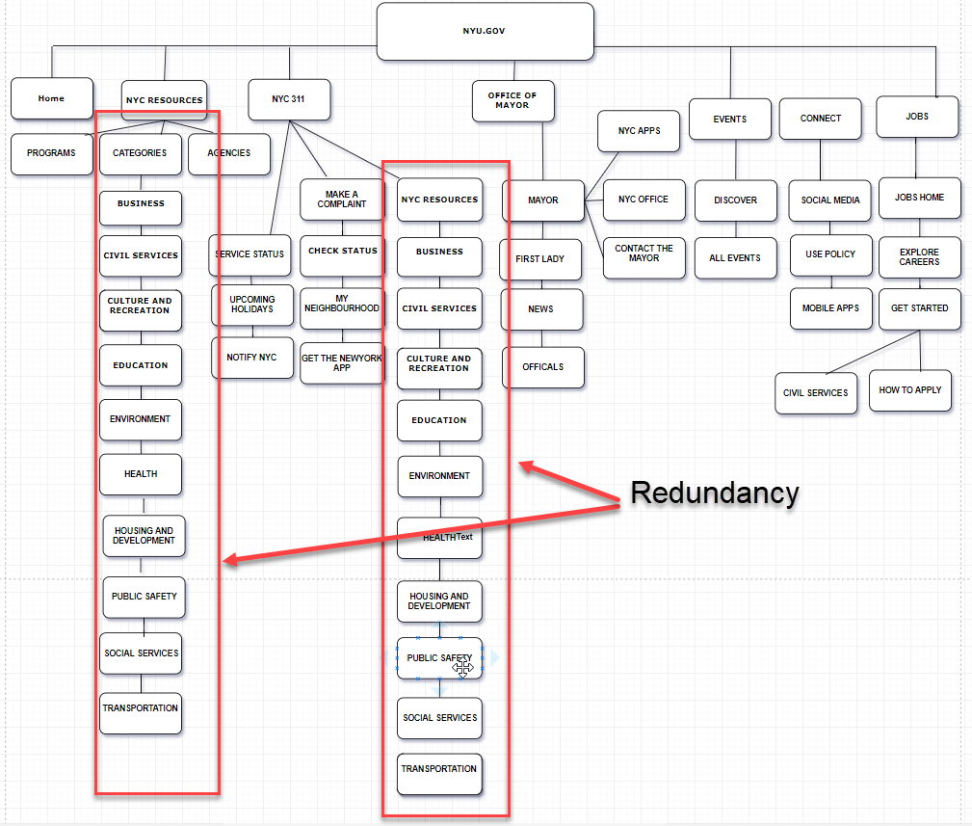
Actual Sitemap

Slide 20
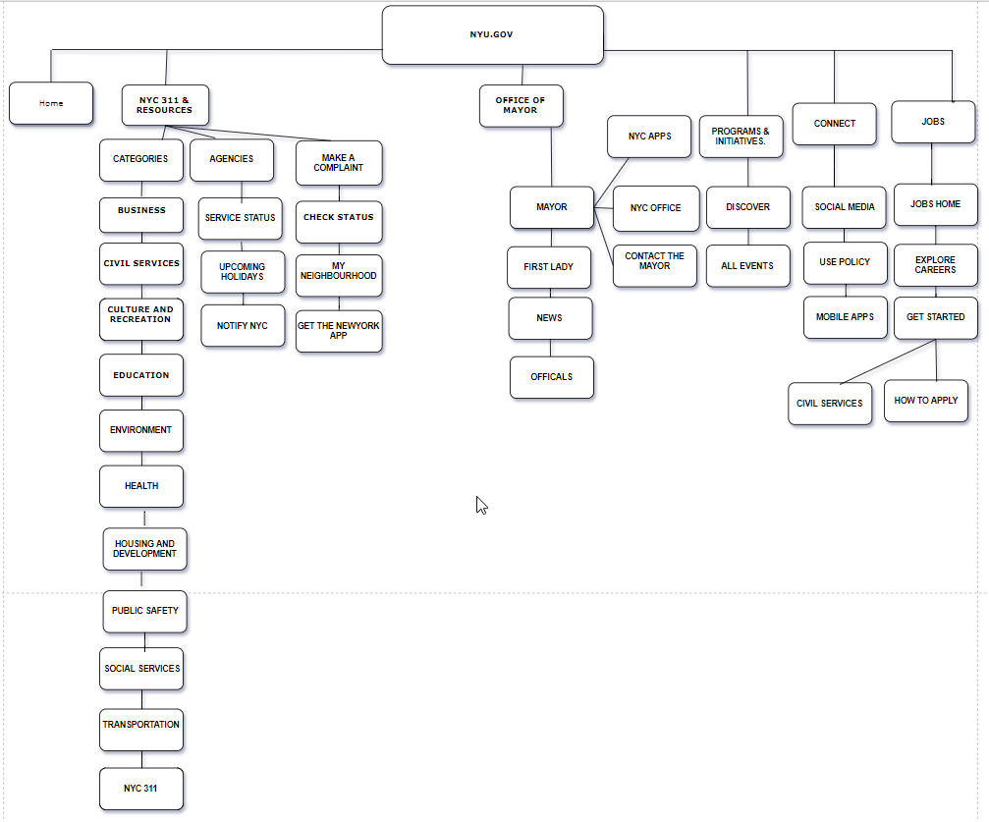
Proposed Sitemap: Narrow and deep navigation structure
The Navigation became narrow because two tabs from global navigation menu were merged into one

Slide 21
Summary of Takeaways:
Solved redundancy and information overload
Combining menus without information loss
from wide and deep => narrow and deep
Prioritized information
Brought the ‘Top Requests’ section towards top of the page with better visibility
Suggested Alerts to be displayed on home page as implemented in the Mobile App

Slide 22
Questions?
Aanshi Shah
Aanshi.Shah@pace.edu
Kajal Purwar
Kajal.Purwar@pace.edu
Nishant Kadu
Nishant.R.Kadu@pace.edu

